Slide 1

SecureVault
Password Manager in x86 Assembly Language
Subject
Semester
Institute
COAL Lab
IV | Fall 2024
NASTP – IIT
Submitted By
Muhammad Haseeb Sajid (F2024CY018)
Submitted To: Ma'am Sibgha

Slide 2
🎯 Objective
Design and implement a secure Password Manager using x86 Assembly Language with the Irvine32 library, demonstrating low-level programming in real-world application development.
🔐 Store Passwords
⚡ Generate Passwords
Securely store website credentials in memory
Generate strong random passwords
🔍 Search Credentials
🛡️ Master PIN Auth
Search saved passwords by website name
Restrict access with PIN-based authentication
🔒 Encrypt & Decrypt
Encrypt/decrypt text using XOR & Caesar cipher

Slide 3
🛠️ Tools & Technologies
MASM
Main assembler used to compile x86 Assembly code
Microsoft Macro Assembler
Irvine32
Provides I/O procedures like ReadString, WriteString, ReadChar for user interaction
Library
x86 ASM
Low-level language communicating directly with processor for fast execution & hardware control
Assembly Language
Visual Studio
Development environment used for coding, building, and debugging the project
IDE

Slide 4
🔐 Encryption Techniques
XOR Encryption
Caesar Cipher
Type: Symmetric Encryption Key: 0xABh Formula:
Encrypted = Char XOR Key Advantages:
Type: Substitution Cipher Shift Value: 3 Encrypt: Char + 3 Decrypt: Char - 3 Example: A → D B → E Z → C
✔ Fast execution
✔ Easy in Assembly
✔ Reversible with same operation
Double Encryption Used in Project:
Password → XOR Encrypt → Caesar Encrypt → Stored in Memory

Slide 5
⚙️ Program Structure & Key Concepts
Procedures (Modular Design)
Arrays & Memory Handling
▸ AddPassword
▸ websites[ ] array
▸ ViewPasswords
▸ usernames[ ] array
▸ SearchPassword
▸ passwords[ ] array
▸ EncryptMenu
▸ Fixed FIELD_LEN per entry
▸ GeneratePassword
▸ Direct memory addressing
▸ XorCrypt
▸ CaesarEncrypt / CaesarDecrypt
Stack Operations
Checksum Validation
▸ PUSH / POP for registers
▸ Adds ASCII values of chars
▸ PUSHA / POPA in procedures
▸ Detects data corruption
▸ Preserves register state
▸ Ensures data integrity
▸ Enables modular procedure calls
▸ Computed per password entry

Slide 6
📋 System Features
Master PIN Authentication
Add Password
01
Hidden PIN input (*), attempt counter, vault lockout after multiple failures
02
Enter website, username & password — auto XOR+Caesar encrypted then stored in arrays
View All Passwords
Search by Website
03
Retrieve passwords from array, temporarily decrypt, and display all credentials
04
String comparison using StrCompare, displays matching credentials
Encrypt / Decrypt Text
Strong Password Generator
05
Manual encrypt or decrypt any text using XOR or Caesar cipher
06
Random password using uppercase, lowercase, digits, symbols via Randomize & RandomRange

Slide 7
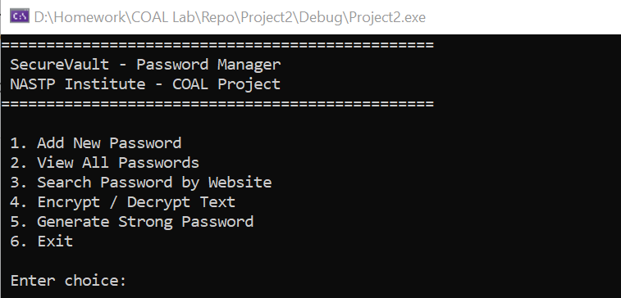
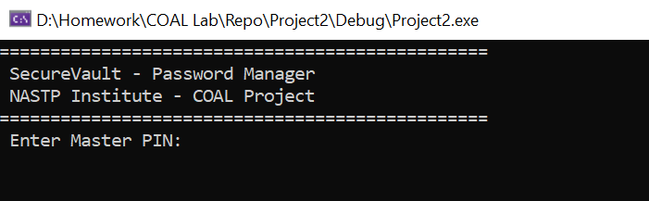
💻 Screenshot: Main Menu
Main Menu Options
1. Add New Password
2. View All Passwords
3. Search by Website
4. Encrypt / Decrypt
5. Generate Password
6. Exit
PIN Authentication Screen
PIN Features:
✔ Hidden input (***)
✔ Attempt counter
✔ Vault locks on failure

Slide 8
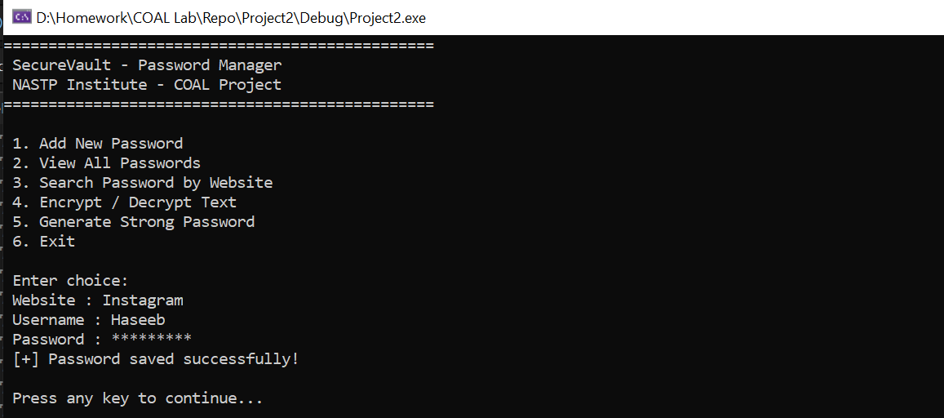
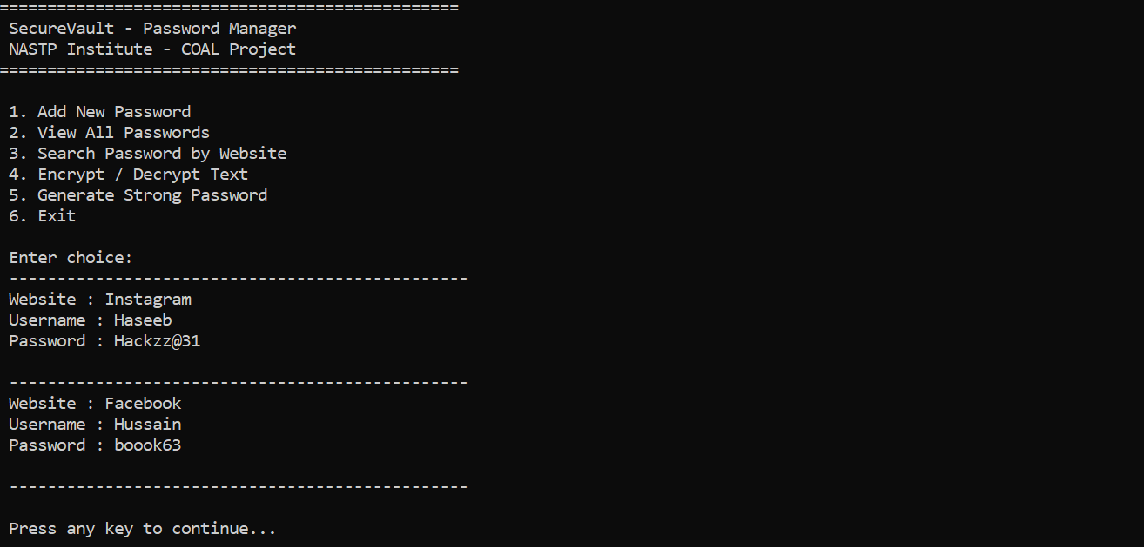
💻 Screenshot: Add & View Passwords
Add Password — Output
User enters website, username, and password — stored with hidden input. Confirmation shown on save.
View All Passwords — Output

Slide 9
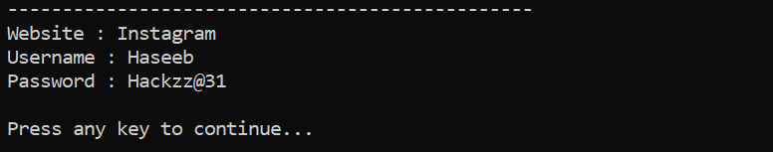
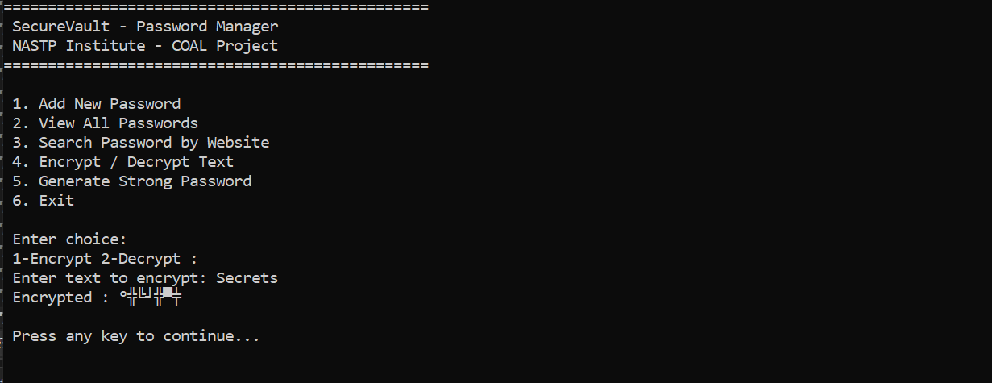
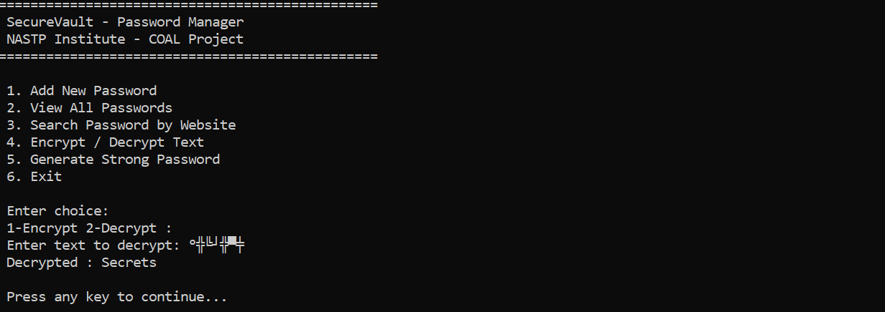
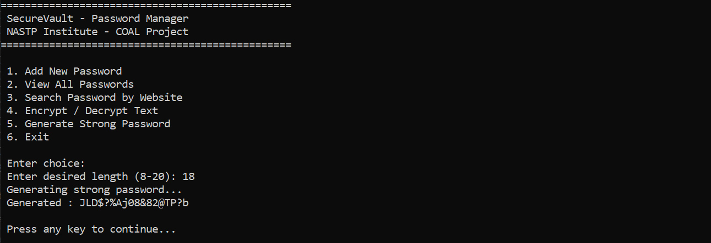
💻 Screenshot: Search & Encryption
Search Feature — Output
Encryption — Output
String comparison via StrCompare — shows matching website credentials.
Decryption — Output
Password Generator — Output

Slide 10
✅ Conclusion
SecureVault successfully demonstrates the practical implementation of Assembly Language concepts through a real-world cybersecurity application.
COAL Concepts Covered:
Key Takeaways
✔ Character I/O
✔ Arrays & Strings
Low-level programming
experience
✔ Procedures & Modular Design
✔ Loops & Conditional Execution
✔ Stack Operations
✔ XOR & Caesar Encryption
Debugging &
modular design
✔ Memory Management
✔ PIN-Based Authentication
Encryption &
authentication internals
COAL theory →
practical application
Thank You | Questions Welcome!

